Slide 1



Welcome to
Acorn Class
All Saints CE Primary School & Nursery
Nurturing, Resilience and Achievement for all!

Slide 2
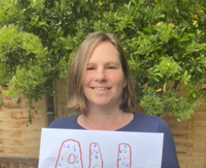
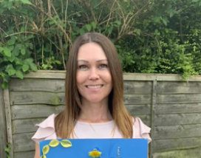
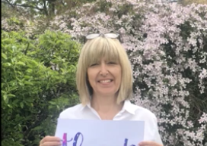
Meet The Grown Ups!
Mrs McFarlane
Class Teacher
Mrs Rogers
Nursery Nurse
Mrs Evans
1 to 1 support

Slide 3
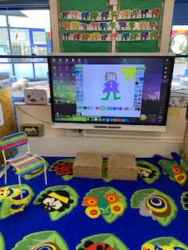
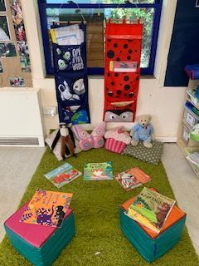
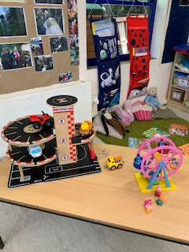
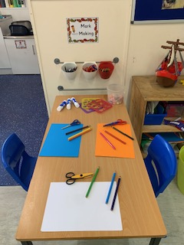
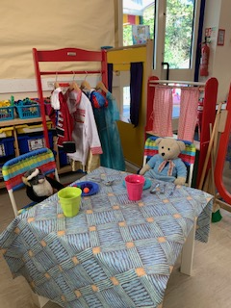
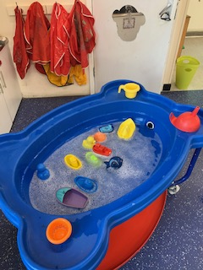
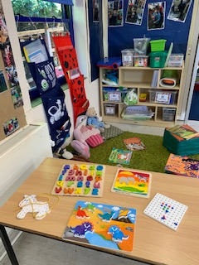
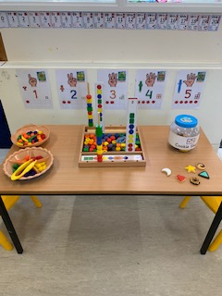
Activities and Curriculum
Your child will learn through adult led activities but also child initiated play. We will get to know them very well; seeing what they love to do and what they need to focus on. We will use this information to plan the next steps in your child’s learning.
Every time your child reaches a milestone or makes some progress, we will make an observation and assessment. We store these observations in an online private environment called Tapestry. In the first few weeks you will be given your own login for Tapestry, giving you the opportunity to see and comment on your child’s learning. We also have a special “All About Me” book where we keep special pieces of work and picture as a journal of their learning in Acorn Class.

Slide 4
My Child’s Day:
8.50
Doors will be opened by Mrs McFarlane or Mrs Rogers and your child will have activities to play with. You are welcome to outside with your child for a short time to settle them – unfortunately we will not be able to let adults into the classroom at the moment due to social distancing rules.
9.15 –11.50
Your child will work as part of the whole class or in smaller groups. Our learning areas will be inside and outside with lots of opportunities for imaginative and discovery play. We have daily milk and snack time with water available.
11.50-12
Doors are opened for collection. Little Ladybirds Preschool is also run from our room so we do appreciate a prompt collection. If your child is staying for the Little Ladybird session in the afternoon, we will stay with them and hand over to the Little Ladybird staff.
If someone other than yourself or named adult is collecting your child, please let us know. Children cannot be released without verbal authorisation from you. Should you be running late, please let the office know asap so we can make arrangements for your child.

Slide 5
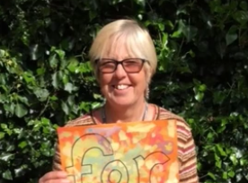
Special Times
Parents and teachers are a team, teaching and helping your child to develop into the little person they will one day become. We foster this relationship through special activities in school.
Regulations permitting, every Tuesday at 11.40 we will open the doors early to allow you to come in for a shared story time. Children will be able to take a class book home to be returned the following Tuesday. On a Friday we will ask you to send in, or email a photo, of something beginning with our “Sound of the Week” for the children to talk about during a circle time.
We will have a “Forest School” sessions where we use the outside woodland areas to learn and explore – children will need to wear their own clothes (that can get muddy!) on Fridays with long sleeves and please bring a waterproof coat.
Our Forest School teacher is Mrs Wignall.

Slide 6
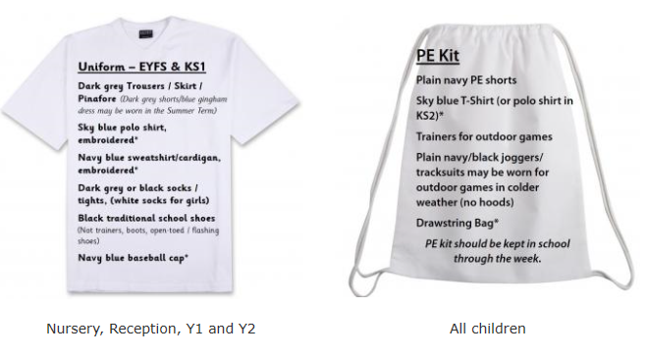
Detail are on the school website http://www.allsaints.herts.sch.uk/website/uniform/419303 with information about how to purchase items.

Slide 7
There will be an opportunity to speak to the teachers during the first week of term before the children start. Any question please email the school office admin@allsaints.herts.sch.uk.
All Saints CE Primary School & Nursery
Nurturing, Resilience and Achievement for all!

