Slide 1


Behaviour at
All Saints

Slide 2

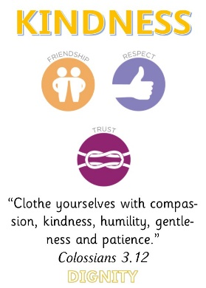
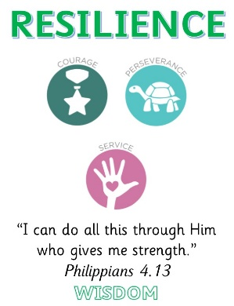

Values based approach
Our new behaviour policy links directly with the four core values of the school:
Nurturing, Resilience and Achievement for All

Slide 3
STEPS Approach
We have adopted the Hertfordshire STEPS Approach to Behaviour Management:
The STEPS Approach:
Therapeutic – recognises behaviour as a form of communication, seeks to find the root cause of behaviour choices
Self Regulation – focuses on teaching internal discipline, rather than imposing external discipline
De-escalation – techniques to de-escalate situations and reduce potential harm
Support and Debrief – provides opportunities to talk through incidents and learn from them
Nurturing, Resilience and Achievement for All

Slide 4
Therapeutic Approach
At the core of our approach is the understanding that there is a reason for all behaviour choices, and it is driven by feelings.
Positive Experiences
Positive Feelings
Positive Behaviour
Negative Experiences
Negative Feelings
Negative Behaviour
All adults in school seek to understand why a child is displaying problem behaviour, and to support them in learning how to change it by using consequences that are designed to create understanding in the child
Nurturing, Resilience and Achievement for All

Slide 5
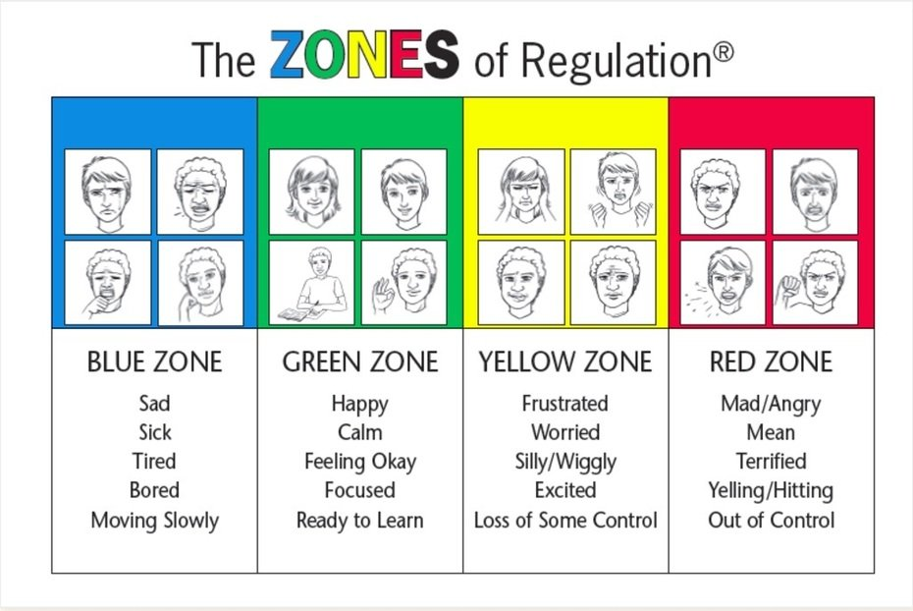
Zones of Regulation
We have launched Zone Boards and lessons to help children gain important skills in self-regulation (internal discipline):
Nurturing, Resilience and Achievement for All

Slide 6
Revised Codes of Conduct
The children have reviewed our codes of conduct, and they now link to the values too:
General Code of Conduct:
We will treat others as we wish to be treated, with kind hands and warm hearts
We will take care of each other and our school community
We will set our goals high, and try hard in everything
We will treat everyone fairly, listen carefully, and be honest.
Playground Code of Conduct:
We will share, take turns and use our hands, feet and voices kindly.
We will play safely, looking after each other and the equipment.
We will include others in our games.
We will be honest and truthful when things go wrong and try to put it right.
Nurturing, Resilience and Achievement for All

Slide 7
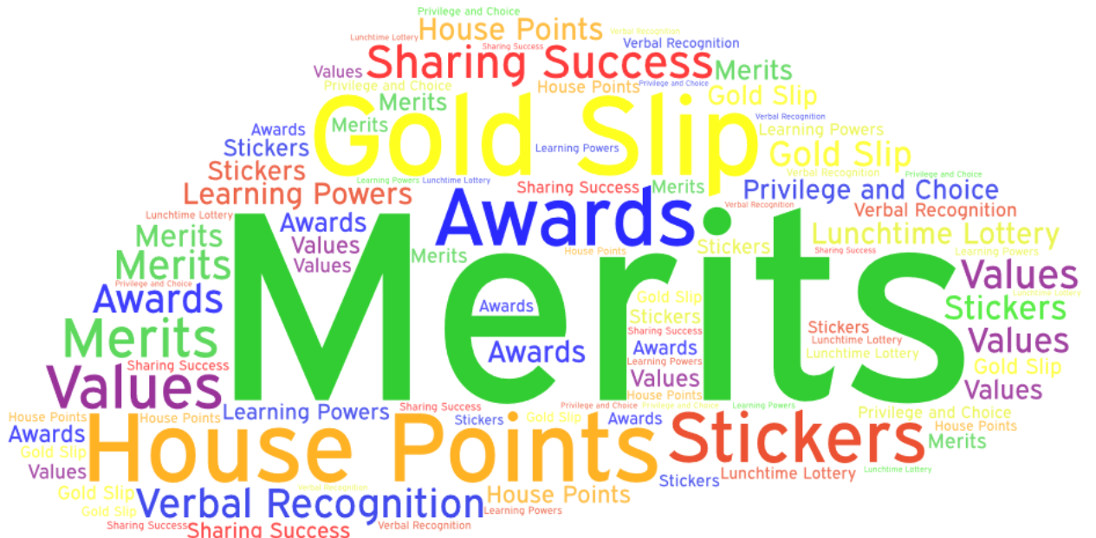
Rewards
Children need to learn that positive behaviour choices can be rewarding in themselves. To help them on this journey, we use a range of methods to reward good behaviour choices.
Nurturing, Resilience and Achievement for All

Slide 8




Rewards - explained
These are the main rewards you will hear about:
House Points: showing values
In the moment rewards for showing school values
To reward team work and collaboration
Totalled up each week and over a half term
Earn a collective reward (afternoon tea) for the whole House Group (with the most points for that half term)
Shared each Friday in Celebration Assembly
Merits: behaviour for learning
Active participation
Deep thinking
Taking risks – challenging themselves
Seeking support and not giving up
Meeting personal targets
Making special contributions
Merits add up to earn certificates – Merit Milestones
Shared each Friday in the Celebration Assembly
St Nicolas
St Alban
St Francis
St Hilda
Nurturing, Resilience and Achievement for All

Slide 9
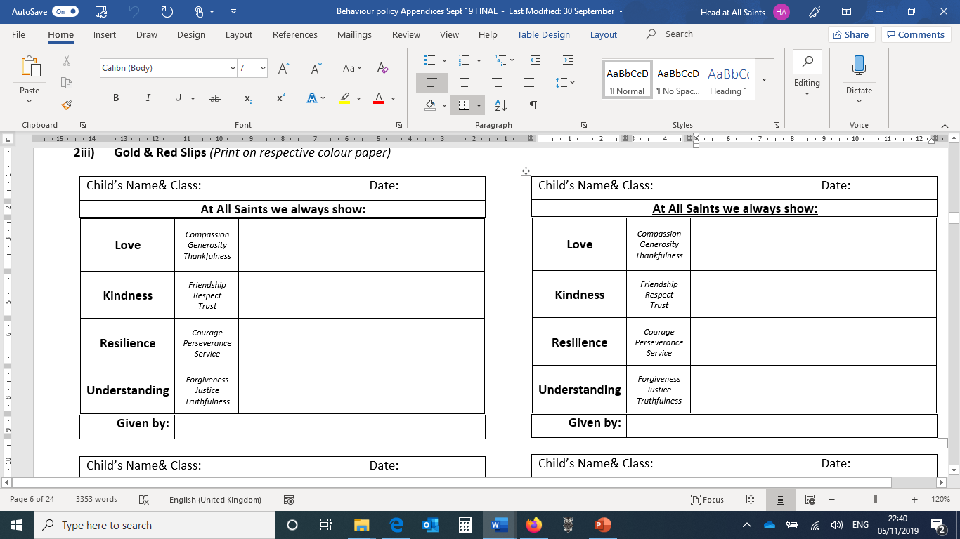
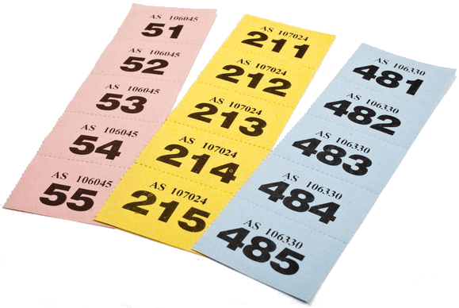
Rewards - explained
These are the main rewards you will hear about:
Gold Slips: outstanding learning, outstanding values
Special praise for going beyond expectations in showing our school values – in work or at play, in school or on trips
Shared with home – gold slip sent home with letter of praise
Lunchtime Lottery: Raffle Tickets at Lunchtime
Showing values in the dining hall
Demonstrating good manners
Helping others (in the hall and on the playground
Weekly draw each Friday – two tickets.
Winning ticket receives a small prize or a Merit (the children choose what they’d prefer)
Nurturing, Resilience and Achievement for All

Slide 10
Consequences - explained
The consequences we use are designed to be Protective and Educational
Protective Consequences: removal of a freedom in order to manage harm, e.g.
Limited access to outside spaces (e.g. missing playtime or reduced time outside)
Differentiated teaching spaces (specific areas/strategies)
Escorted in social situations (e.g. at playtime)
Outside agency support (e.g. ASPECTs)
Individual Risk Management Plans
In extreme instances, exclusion
Educational Consequences: learning or rehearsing so a freedom can be returned e.g.
Completing a ‘Reflect and Repair’ sheet
Rehearsing appropriate behaviours
Completing tasks or unfinished work
Restorative meetings
Assisting with repairs
Listen, Learn, Do, Play cards
Nurturing, Resilience and Achievement for All

Slide 11
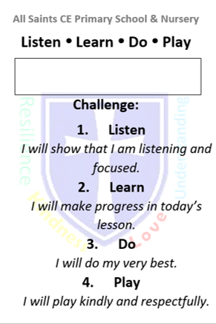
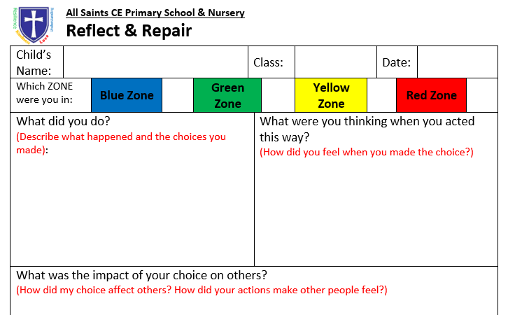
Consequences - explained
Ways we respond to difficult behaviour:
Cumulative Responses:
Non-verbal reminders
Verbal reminders (usually this is enough to change most behaviour)
Class-based time out (change of place in class)
Miss play/lunch time – complete unfinished work or a ‘Reflect and Repair’ Sheet
Time out in neighbouring class (work taken to complete)
Red Slip (where behaviour is significantly below expectations)
Time out with the Headteacher/Deputy or other member of the Senior Leadership Team
20/20/20 Lunchtime Routine
Listen, Learn, Do, Play report card
Internal Exclusion (part day or whole day working elsewhere in school)
Nurturing, Resilience and Achievement for All

Slide 12
Gold and Red Slips
We have introduced Gold and Red Slips this year:
Gold Slips: outstanding learning, outstanding values
Special praise for going beyond expectations in showing our school values – in work or at play, in school or on trips
Shared with home – gold slip sent home with letter of praise
Red Slips: behaviour is significantly below expectations
Disrespectful to adults and peers
Hurting others or damaging property
Disrupting class learning or refusing to complete tasks
Shared with home – red slip sent home with letter
Nurturing, Resilience and Achievement for All

Slide 13
Parents in Partnership
We recognise everyone has a role to play in ensuring pupils behaviour their very best.
We aim to ensure we communicate positively and regularly with all our parents.
We ask all parents to be supportive of the school’s systems of praise and consequence, and to help their child understand the school’s values.
How parents can be supportive:
Talk to your child – ask what they found fun today!
Praise them for good behaviour choices (at home and at school!)
Celebrate rewards – (display them on the fridge/cupboards)
Talk to your child about when things have gone wrong
Reflect on the school values – what they mean and how they are shown
Encourage a positive attitude towards school – discuss parental concerns away from them (and come to speak with us – we can’t help if we don’t know)
Make sure your child has all they need to do well (correct uniform, PE kit and book bag)
Nurturing, Resilience and Achievement for All

